Slide 1
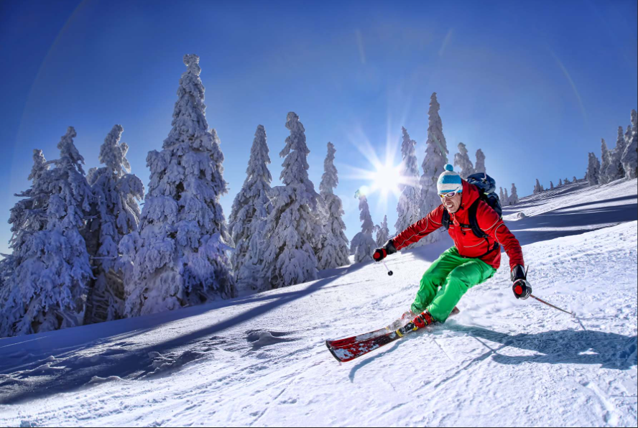

Big Mountain Ski Resort
Business proposal

Slide 2
Business Problem
Big Mountain Ski Resort located in Montana recently added a quad speed chair lift costing $1,540,000.
Purpose: Find areas of opportunity for the resort to increase revenue so that the resort can both pay for the new operating costs but also be profitable.
Problem: How will Big Mountain Resort decide on a fair ticket price and reduce operational costs while staying competitive within the sector and not be overpriced out of the market?

Slide 3
Key Findings
Three Key Findings:
1. Keep everything the same while raising ticket prices by $1, increasing revenue by $3,400,000
2. Increase the vertical drop by 150 feet, add a chair lift while raising ticket prices by $1.99 which predicted revenue increase by $3,474,638 per season
3. Increase snow-making by 0.2 acres and raise ticket prices by $1.99, which predicated revenue increase by $3,474,638 per season

Slide 4
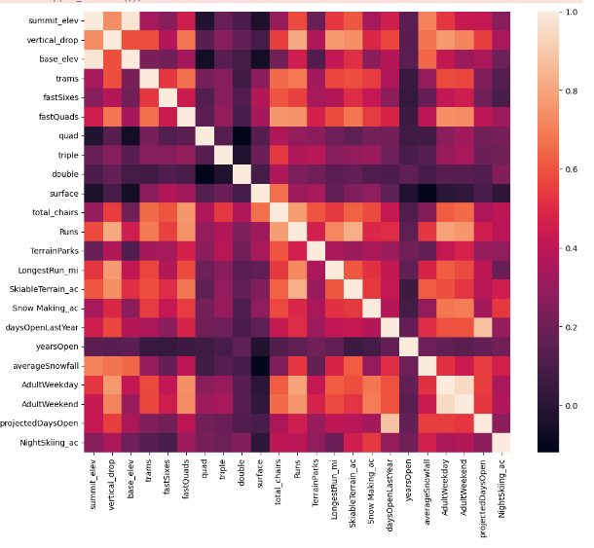
Analysis: Correlation Matrix
Correlation Matrix
Vertical Drop
1. Runs
2. Longest Run
3. Skiable Terrain
4. Ticket Price
Fast Quads
1. Total Chairs
2. Runs
3. Skiable Terrain
4. Ticket Price

Slide 5
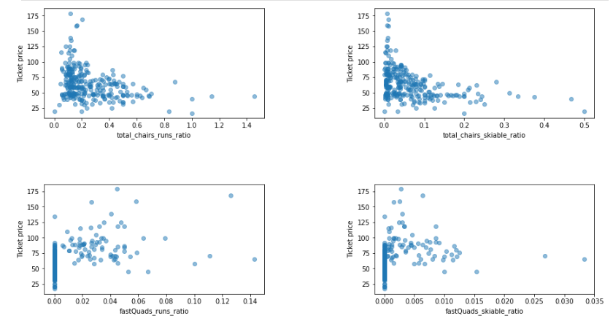
Analysis: Scatter Plot
Scatter Plot
Ticket price vs.
1. Total Chair runs ratio
2. Fast Quad runs ration
3. Total Chair skiable ratio
4. Fast Quad skiable ratio
Summary
Fast Quad runs ratio has highest potential to raise ticket prices

Slide 6
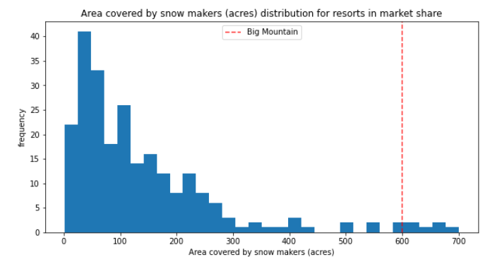
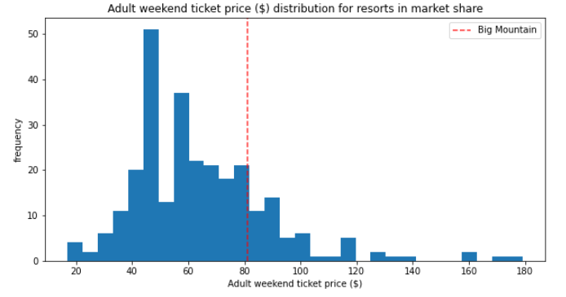
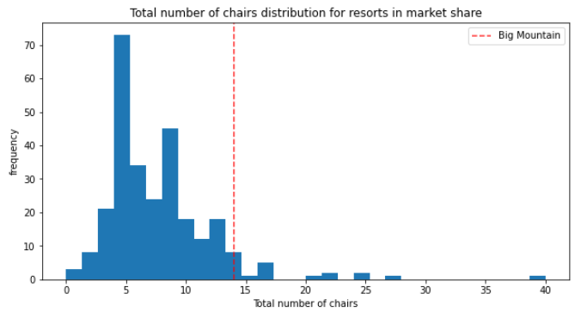
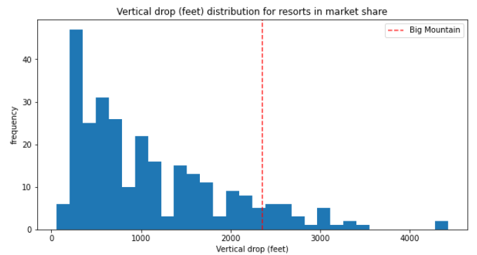
Analysis: Histograms
Summary
The red line expresses Big Mountain Resort position for each of the measures.
Snow making (Acres)
Total number of chairs
Weekend ticket price
Vertical drop
Summary
Big Mountain Resort is in a good position to raise ticket prices given all of the accommodations offered compared to other resorts

Slide 7
Conclusion
Given Big Mountain Ski Resort and its local market, the resort offers many more features and accommodations compared to most. In addition to not having to change anything in order to raise ticket prices by $1, the resort can make a few small investments in order to justify raising the prices by $1.99 which will enable the resort to increase revenue, pay for the speed quad lift while maintaining competitive within the market.

